Slide 1

Predictive Analytics for Business Strategy

Slide 2
By the end of this class, you should be able to:
Explain the difference between active prediction and passive prediction.
Explain when a firm/person/etc. would want/need to engage in active prediction versus when they would be engaging in passive prediction.
Discuss what kinds of models would be appropriate to use for active prediction and which for passive prediction and why they would be appropriate.

Slide 3
Active prediction
Active prediction requires the identification of a causal relationship.
Thus far, we only know how to do that with experimental data (RCT).
Later, we’ll learn some strategies for how to approximate this with observational data.

Slide 4
Passive prediction
With passive prediction we’re essentially saying, “if we see this/theses change(s)/values in/of X in the real world, we bet/predict we’ll see this change/value in/of Y in the real world.”
This REQUIRES observational data since the treatment has not been randomized.
Who gets a treatment (like college, a vaccine, etc.) looks very different in experimental data than in the real world
So we can’t use experimental data to make passive predictions.

Slide 5
Active Prediction definition
Active prediction is the use of predictive analytics to make prediction based on actual and/or hypothetical data for which one or more variables are exogenously altered.
Translation – when you (a company, etc.) are actively changing one or more variables and you want to predict what impact this will have on the outcome.
Let’s actively predict what would happen so we can make a good decision.
Or decide to do nothing.

Slide 6
Active prediction examples
Your firm is thinking of increasing its ad spend.
You are thinking of a different price strategy.
The firm is thinking of laying off 10 employees.
The key with all of these is someone is actively changing one of the variables that they have control over (or considering doing so, or advising someone who is).

Slide 7
Active prediction “timeline”
How does active prediction “work”?
Suppose we are considering changing a particular X variable (e.g. price of our product)
First, we need to estimate the causal impact of price on an outcome variable
Likely quantity sold, profit, or revenue; let’s use Q
Once we estimate the effect of X on Y (P on Q), we can actively predict what would happen if we increase P.
Upon doing so, we then decide if we actually want to increase P.
Or at least we inform the CEO of the active prediction and they decide.

Slide 8
Passive Prediction definition
Passive prediction is the use of predictive analytics to make prediction based on actual and/or hypothetical data for which no variables are exogenously altered.
Translation – If we observe certain changes in X1, X2, and X3 (for example), what change in Y would we expect?
Or, if we see certain values of X1, X2, X3, etc., what value of Y would we expect?
The key here is that we aren’t the ones making the changes in X1, X2, and X3.

Slide 9
Why aren’t we making the changes
In passive prediction, we’re just observing what is happening to one or more X values.
Why?
Some variables no one has control over (weather, day of year, etc.)
Others we’re just observing what is happening.
When we observe high prices of hotel rooms in Miami, if we’ve identified a positive correlational effect, we can passively predict a higher quantity of rooms sold.

Slide 10
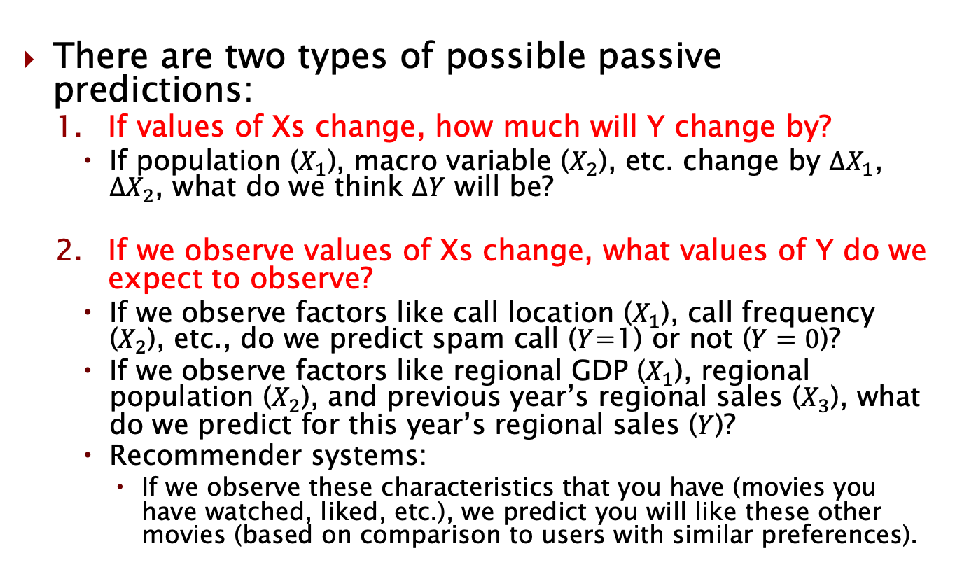
Passive prediction examples
There are two types of possible passive predictions:
If values of Xs change, how much will Y change by?
If population ($X_{1}$), macro variable ($X_{2}$), etc. change by $ΔX_{1}$, $ΔX_{2}$, what do we think $ΔY$ will be?
If we observe values of Xs change, what values of Y do we expect to observe?
If we observe factors like call location ($X_{1}$), call frequency ($X_{2}$), etc., do we predict spam call ($Y$=1) or not ($Y=0$)?
If we observe factors like regional GDP ($X_{1}$), regional population ($X_{2}$), and previous year’s regional sales ($X_{3}$), what do we predict for this year’s regional sales ($Y$)?
Recommender systems:
If we observe these characteristics that you have (movies you have watched, liked, etc.), we predict you will like these other movies (based on comparison to users with similar preferences).

Slide 11
The prediction is the easy part
One thing you will see is that the actual prediction is the easy part.
Simple multiply your coefficient(s) by your value(s) of X (or changes in X) and add the y-intercept for passive prediction.
For active prediction, it’s even easier:
Assuming one variable of interest, simply multiply the desired change in that X variable by the estimated coefficient.
Determining if the model is exogenous (no factors messing up our ability to estimate the causal impact of X on Y) or not is the hard part.

Slide 12
Telecom customer churn example

Slide 13
Telecom customer churn
Let’s take a look at (TelecomCustomerChurn.dta). Run the following regression and discuss:
reg churn_num monthlycharges tenure seniorcitizen
How do we interpret the coefficients?
Can we interpret it causally?
Can we use it to make an active prediction?
What about a passive prediction?

Slide 14
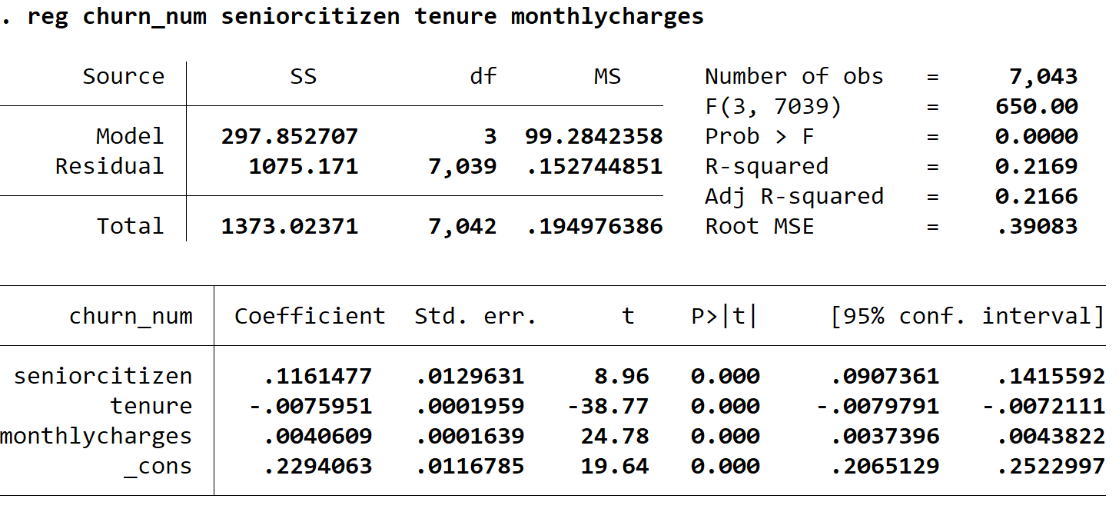
Telecom customer churn

Slide 15
Passive prediction
What would you passively predict is the probability of churning for a senior citizen who has been a customer for 10 periods and has monthly charges of $30?

Slide 16
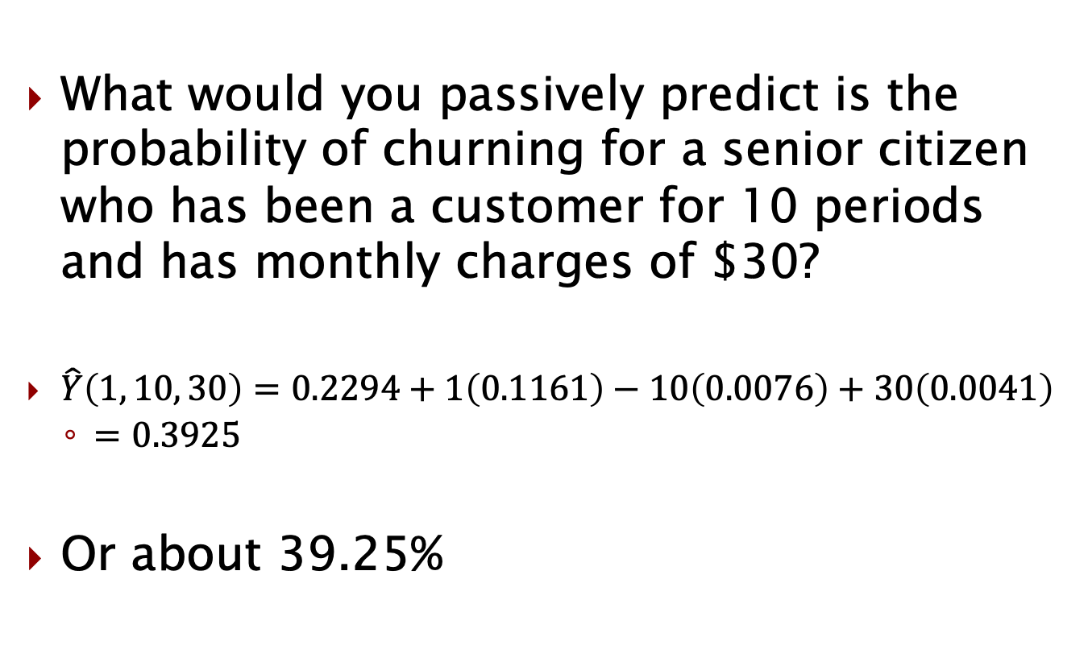
Passive prediction (level)
What would you passively predict is the probability of churning for a senior citizen who has been a customer for 10 periods and has monthly charges of $30?
$\hat{Y}\left(1, 10, 30\right)=0.2294+1\left(0.1161\right)−10\left(0.0076\right)+30\left(0.0041\right)$
$=0.3925$
Or about 39.25%

Slide 17
Passive prediction (change)
How much more/less likely would we passively predict customers who pay $10 more per month are to churn?

Slide 18
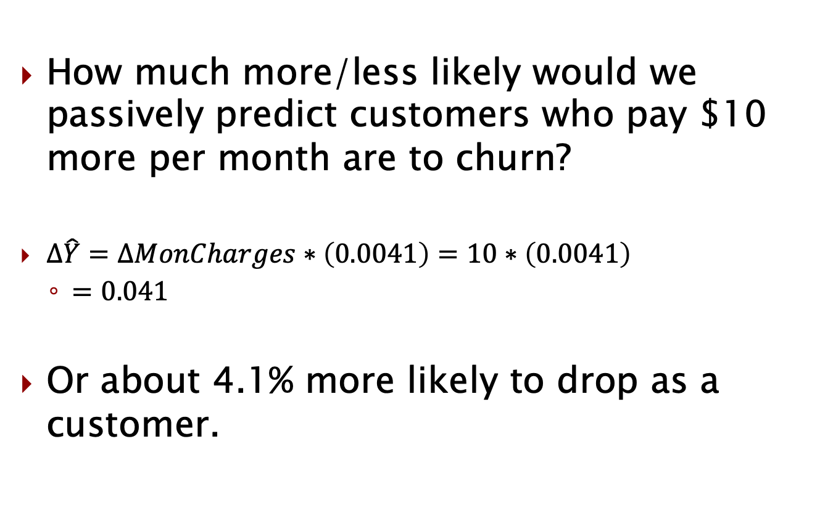
Passive prediction (change)
How much more/less likely would we passively predict customers who pay $10 more per month are to churn?
$Δ\hat{Y}=ΔMonCharges∗\left(0.0041\right)=10∗\left(0.0041\right)$
$=0.041$
Or about 4.1% more likely to drop as a customer.

Slide 19
Actively predicting churn?
Is there any type of active prediction the telecom company might want to do?
What kind of data would they need?
(based on what we know thus far in the class)

Slide 20
NYC Taxi data example

Slide 21
NYC Taxi Data examples
Let’s use the public NYC Taxi data again.
Suppose you’re advising HR of a company that hires taxi drivers and you’re curious about the tips that they get. Run this regression:
reg tip_am payment_credit fare_amount tolls_amount passenger_count
Can you use this model for:
Active prediction?
Passive prediction?

Slide 22
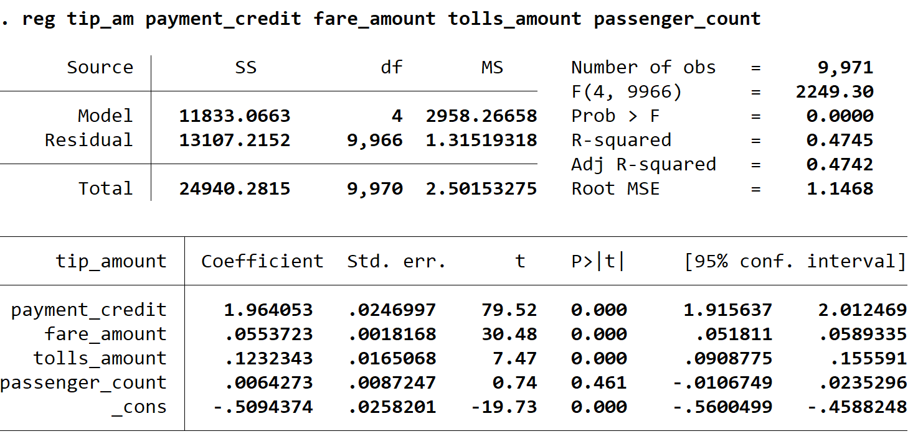
NYC Taxi Data

Slide 23
Suppose we did use it for passive
What would we be saying if we did use it for passive prediction?
If we passively predicted the tip amount when:
The person paid with a credit card
Fare = $22
Tolls = $1.75
Passengers = 3

Slide 24
Variables that are not significant
In models to be used for passive prediction, every effect has to be significant.
Why? We may use every coefficient (and the constant term) in our passive prediction.
What about models for active prediction?
We only have one variable of interest (most cases)
We just need its coefficient to be significant.
We will only use it in active prediction.
We will not use the constant or other coefficients.

Slide 25
Click-through rate example

Slide 26
Click-through rates
Suppose Google decided to randomly assign the top position in the search results for a given search to a random sample of users.
Compared to the 2nd position
They wanted to learn what the impact was on having the first position so they could determine optimal pricing.
(if they were able to do this)

Slide 27
Click-through rates
Using Class 3.1 data, run the following regression and discuss:
reg Click Topposition
Can you use this model for:
Active prediction?
Passive prediction?
Explain why or why not on each.

Slide 28
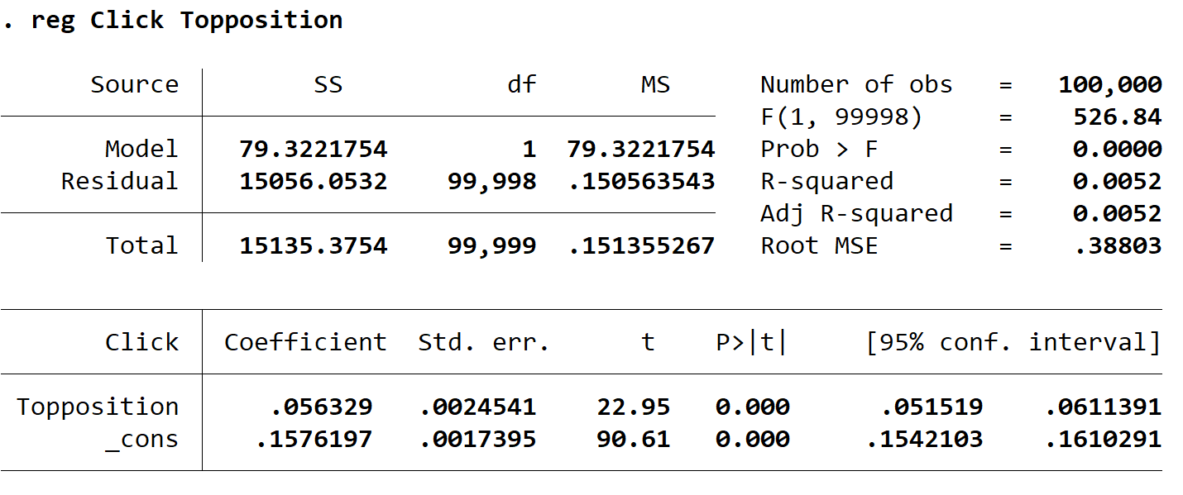
Click-through rates

Slide 29
What if it was observational data?
If this had been observational data, do you think the coefficient on topposition would have been higher or lower than what we saw from the RCT case?
(assume there is no ability to pay for a higher position here)

Slide 30
Active prediction
Actively predict how much the click-through rate would increase for a firm that was in the 2nd position and paid to get bumped up to the 1st position?

Slide 31
Decisionmaking In Practice: Abraham Wald Example

Slide 32
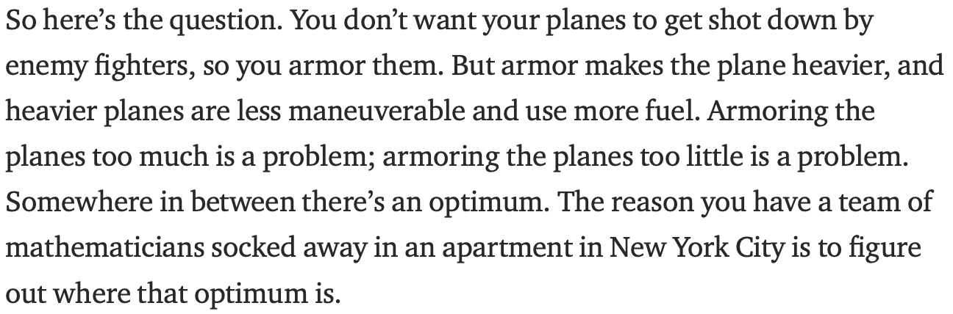
Abraham Wald Example
Statistical Research Group (SRG) in NYC during World War II.
Decision to make: where to put the armor?
Goal: survival of aircrafts while minimizing armor placement
Prediction to make: damage by the sections (where do we get hit the most?)
An excerpt from How Not To Be Wrong by Jordan Ellenberg

Slide 33
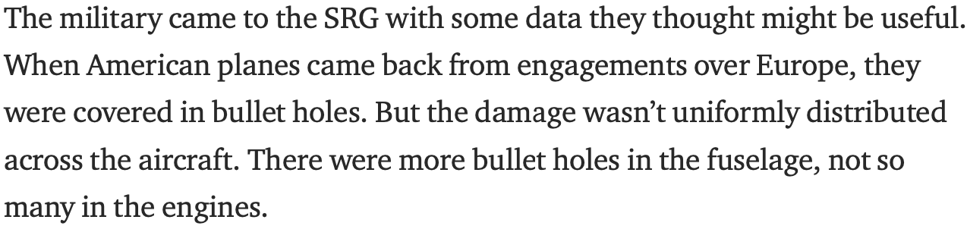
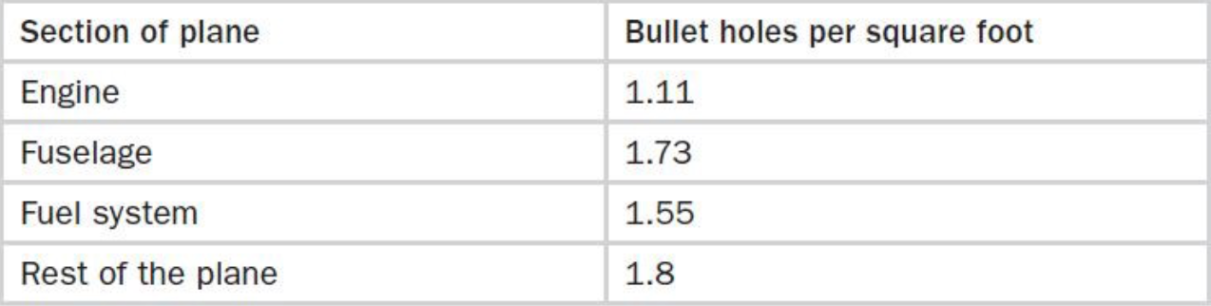
What Does The Data Say?

Slide 34
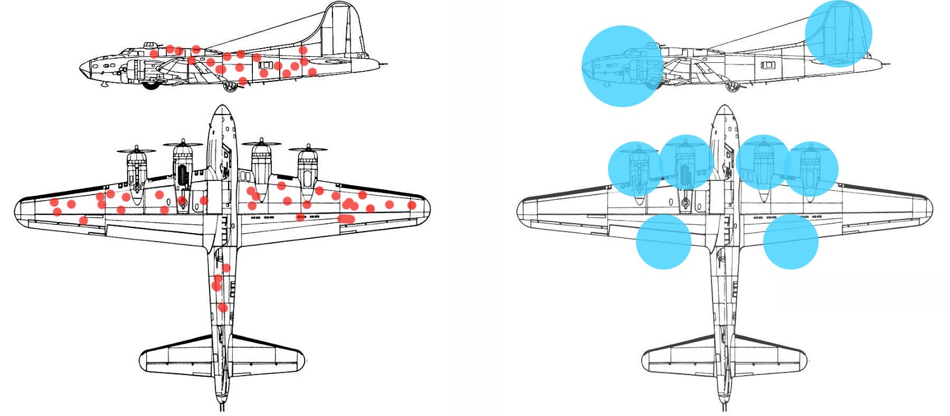
Data shows the prediction of damage by sections
If the section is fuselage (X) then there is a lot of damage (Y)
If the section is engine (X) then there is no damage (Y)

Slide 35
What decision would you make based on the observed data and the prediction?
Where would you put the armor?
Before taking this class:
After taking this class:

Slide 36
What decision would you make based on the observed data and the prediction?
Where would you put the armor?
Before taking this class:
Fuselage
After taking this class:
Engine

Slide 37
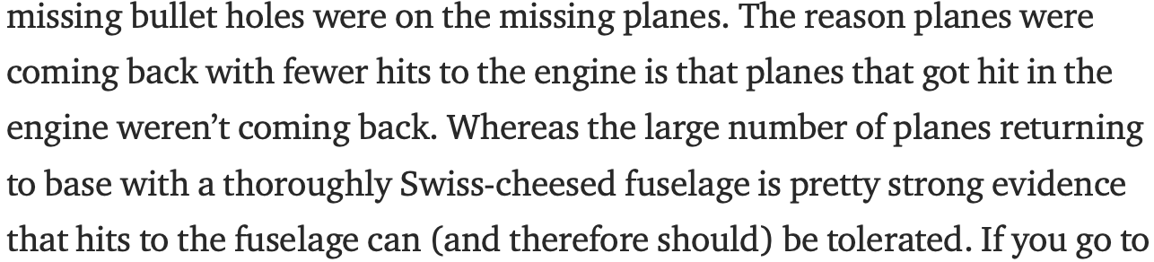
What mistake was made?
What mistake is made by those who haven’t taken a class in causal inference? (a common type of mistake)

Slide 38
What mistake was made?
What mistake is made by those who haven’t taken a class in causal inference? (a common type of mistake)
They observe a correlation between X and Y
They can imagine a mechanism through which X caused Y
They make an active prediction based on the correlation estimated in step 1

Slide 39
Announcements
Quiz 1 this Friday (notify me of any conflicts)
Will cover material through Class 2.2.
Practice quiz 1 & solutions available

